Slide 1
Faculty of Nursing
Cairo University
2nd Semester Doctorate Program
2024-2025
Interpretation of Test Scores
Under Supervision of :
Prof. Dr. Effat Mohammed
Prof. Dr. Inas Helmy
Prof. Dr. Heba Ahmed
Prepared by:
Sherine abd elmoneem
Amal Sobhy

Slide 2
Objectives
At the end of discussion, every candidate will be able to:
Interpret test scores , Scores and Raw score
Discuss importance of interpreting test scores.
Utilize and apply different statistical methods (tables and graphs) for test score distributions .
Differentiate between characteristics of test score distribution
Apply measures of central tendency and measures of variability to describe test scores.
Distinguish between methods for interpreting individual test scores: teacher-made tests ,standardized tests, Norm reference interpretation and criterion reference interpretation.
Apply percentile rank and percentage of correct scores for a test score.

Slide 3
Outlines:
Introduction
Definitions
Importance of interpretation of test scores
Importance of interpretation of test scores for teacher , student and course.
Methods of test score distributions: (tables & graphs).
Characteristics of test score distribution.
Measures of central tendency and variability.
Interpretation of individual test score:
Teacher-made test
Norm reference interpretation
Criterion reference interpretation.
Standardized test.
Rank and percentage of correct scores for a test score.
Technology integration in test interpretation

Slide 4
Introduction
Interpretation of test score is a measurement Tool for a test results in a score—a number, this number, has no intrinsic meaning and must be compared with something that has meaning to interpret its significance. (Reynolds, Altmann, 2021).

Slide 5
Definitions:
Interpretation of test Score
Is the process of analyzing test scores and converting qualitative data into quantitative and grading into numerical values. (Reynolds, Altmann, 2021).
Scores:
The evidence summary provided in an examinee's responses to test questions that related to the construct or constructions being measured.
Raw scores
the number of correct answers received on a test.
Example: A Student got 75 out of a 100 scores in item quiz.

Slide 6
Importance of interpretation of test scores:
A Basic knowledge of statistical concepts is required disregard the interpretations are norm-referenced or criterion-referenced to :
1- Assess the quality of tests
2- Understand standardized test scores
3- Summarize assessment results.
4- Explain test scores to others.

Slide 7
Importance of interpretation of test scores, cont.,
For Teachers
For Students
For Courses
Instructional Planning
enables teachers to tailor their teaching strategies to address students' strengths and weaknesses.
Identifying Learning Gaps: allowing for targeted interventions
Evaluating Teaching Effectiveness
assess the impact of their instructional methods and make necessary adjustments.
Self-Assessment: students understand their progress and areas needing improvement.
Motivation:
motivate students to set and achieve learning goals.
Curriculum Development: Aggregated test data informs curriculum adjustments to better meet educational objectives.
Accreditation and Accountability: Test scores serve as indicators of course effectiveness, essential for accreditation processes

Slide 8
Importance of test interpretation
1- identifies learning gaps :
Accurate interpretation helps teachers identify specific areas where students struggle, allowing for targeted interventions and support.
2- monitors progress:
It helps track student progress over time, showing whether learning objectives are being met and informing necessary adjustments.

Slide 9
Importance of test interpretation cont;
3- informs instruction:
Test results guide educators in adjusting lesson plans and teaching methods to better suit the learning needs of students.
4- promotes individualized learning:
Proper interpretation allows educators to tailor instruction to individual learning styles and abilities, enhancing student engagement and outcomes.
5- support fair evaluation:
Interpreting tests fairly and accurately ensures that student assessments are objective and based on clear criteria.

Slide 10
Importance of test interpretation cont;
6- encourage student self-reflection:
When test results are explained clearly, students can reflect on their performance, understand their strengths and weaknesses.
7- guides policy and curriculum decisions:
At a broader level, aggregated test interpretations can inform educational policy, curriculum development, and resource allocation.

Slide 11
Methods of test score distributions: (tables & graphs)
Score Distribution
After a test is scored, the teacher is left with a collection of raw scores.
These scores usually are recorded according to the names of the students, in alphabetical order, or by student numbers

Slide 12
Test Score distribution
Did a majority of students obtain high or low scores on the test?
Are the scores widely scattered or grouped together?
What was the range of scores obtained by the majority of the students?
Did any student score much higher or much lower than the majority of the students?

Slide 13
Methods of Test Score Distribution
First and important step is :
The data must be organized in order as an essential step before any interpterion or further use.

Slide 14
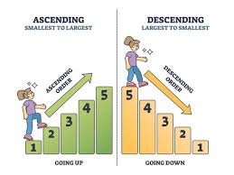
Methods of Test Score Distribution ( Tables)
The teacher still cannot visualize easily how a typical student performed on the test or the general characteristics of the obtained scores.
Rank Tables : The rank functionality will
add a ranking number to the items in a table
based on the result , It can be arranged in
descending or ascending order .

Slide 15
EXAMPLE of : Exam result for 6 student / Total score 95 (Rank Table)
RANK | SCORE | STUDENT
1 | 93 | A
2 | 85 | B
3 | 83 | C
4 | 79 | D
5 | 70 | E
6 | 66 | F

Slide 16
Methods of Test Score Distribution ( Tables) cont.
Frequency Tables : A frequency distribution table is a method to organize the data given so that it makes it more meaningful and easier to understand.

Slide 17
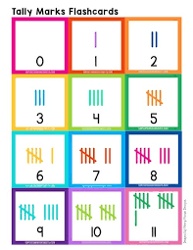
Methods of Test Score Distribution ( Tables) cont., Example 1
The following list marks for Nursing Management and Leadership assignment of 20 students were as follows: 6 7 5 7 7 8 7 6 9 7 4 10 6 8 8 9 5 6 4 8
Present this information in a frequency table

Slide 18
Methods of Test Score Distribution ( Tables) cont. Example 1
Step 1:
Construct a table with three columns. The first column shows what is being arranged in ascending order (i.e. the marks). The lowest mark is 4. So, start from 4 in the first column as shown below.

Slide 19
Methods of Test Score Distribution ( Tables) cont. Example 1
Step 2:
Go through the list of marks. The first mark in the list is 6, so put a tally mark against 6 in the second column. The second mark in the list is 7, so put a tally mark against 7 in the second column. The third mark in the list is 5, so put a tally mark against 5 in the third column as shown below.
Continue this process until all marks in the list are tallied.

Slide 20
Methods of Test Score Distribution ( Tables) cont. Example 1
Step 3:
Count the number of tally marks for each mark and write it in third column. The finished frequency table is as follows:

Slide 21
Methods of Test Score Distribution ( Tables) cont. Example 2
Class Intervals (or Groups)
When the set of data values are spread out, it is difficult to set up a frequency table .
Group the data into class intervals (or groups) to help in organize, interpret and analyze the data.
The frequency of a group (or class interval) is the number of data values that fall in the range specified by that group (or class interval).
Each group starts at a data value that is a multiple of that group. For example, if the size of the group is 5, then the groups should start at 5, 10, 15, 20 etc.

Slide 22
Methods of Test Score Distribution ( Tables) cont. Example 2
The number of calls from motorists per day for roadside service was recorded for the month of December 2003. The results were as follows:
Set up a frequency table for this set of data values

Slide 23
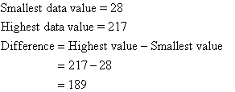
cont. Example 2

Slide 24
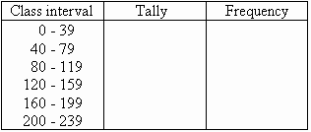
cont. Example 2
Step 1: Construct a table with three columns, and then write the data groups or class intervals in the first column. The size of each group is 40. So, the groups will start at 0, 40, 80, 120, 160 and 200 to include all of the data. Note that in fact we need 6 groups

Slide 25
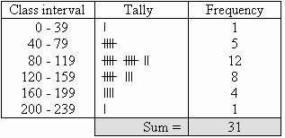
cont. Example 2
Step 2-3: Count the number of tally marks for each group and write it in the third column. The finished frequency table is as shown:

Slide 26
Methods of Test Score Distribution (Graphs) cont.,
1- Bar chart :
A bar chart is a representation of numerical data in pictorial form of rectangles (or bars) having uniform width and varying heights." They are also known as bar graphs.
Bar charts can present the different types of data. (Qualitative or quantitative)

Slide 27
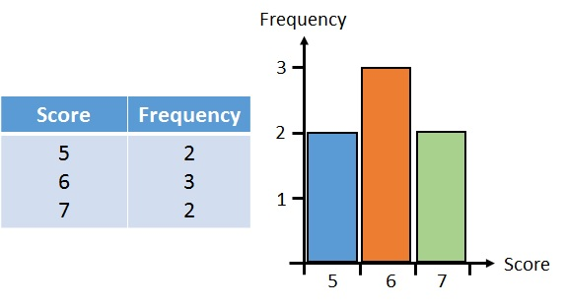
Example : Bar chart

Slide 28
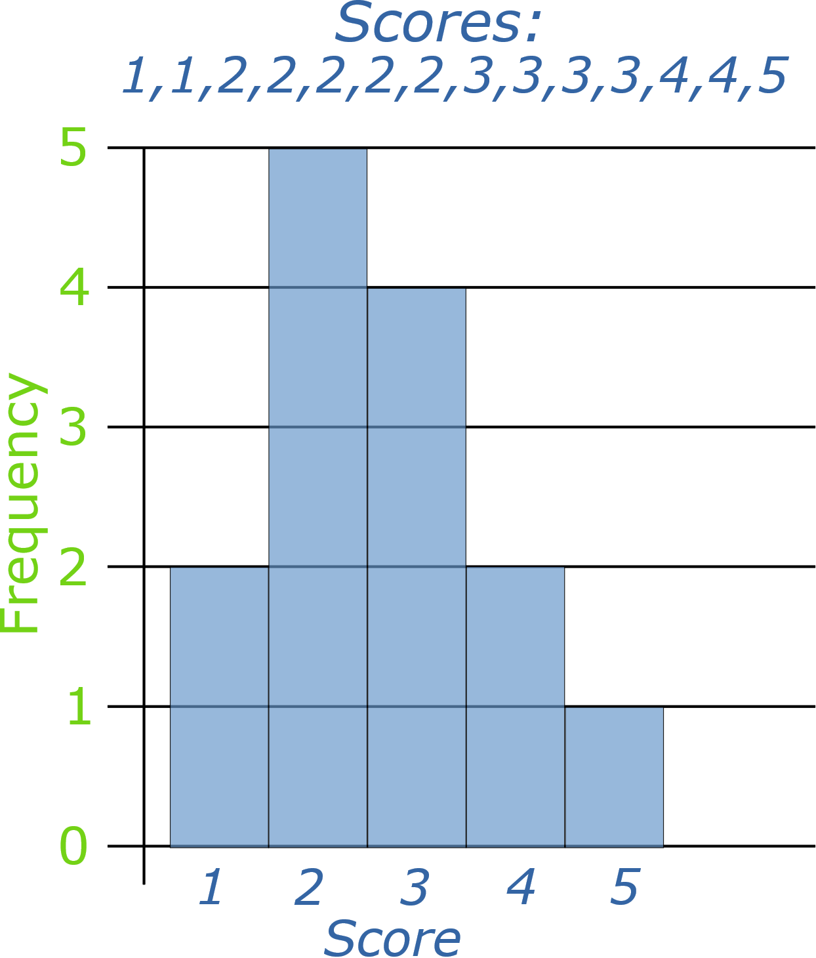
Methods of Test Score Distribution Cont., ( Graphs)
2- Histogram
A frequency distribution shows how often each different value in a set of data occurs.
A histogram is the most commonly used graph to show frequency distributions.
Frequencies are indicated on a histogram by bars, with the height of each bar representing the frequency of the corresponding score.

Slide 29
Methods of Test Score Distribution cont., (Graphs)
3- A frequency polygon
is almost identical to a histogram, which is used to compare sets of data or to display a cumulative frequency distribution. It uses a line graph to represent quantitative data.
a visually substantial method of representing quantitative data and its frequencies
The dots then are connected with straight lines to form a polygon or curve.

Slide 30
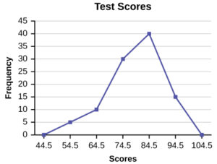
Graphs: A frequency polygon
A dot is made above each score value to indicate the frequency with which that score occurred; if no one obtained a particular score, the dot is made on the baseline, at 0. The dots then are connected with straight lines to form a polygon or curve

Slide 31
Characteristics of test score distribution
1-SYMMETRY :
Symmetric
2-MODALITY
Unimodal
Bimodal
Multimodal
3- SKEWNESS
Asymmetric
4- KURTOSIS
Leptokurtic
Mesokurtic
Platykurtic

Slide 32
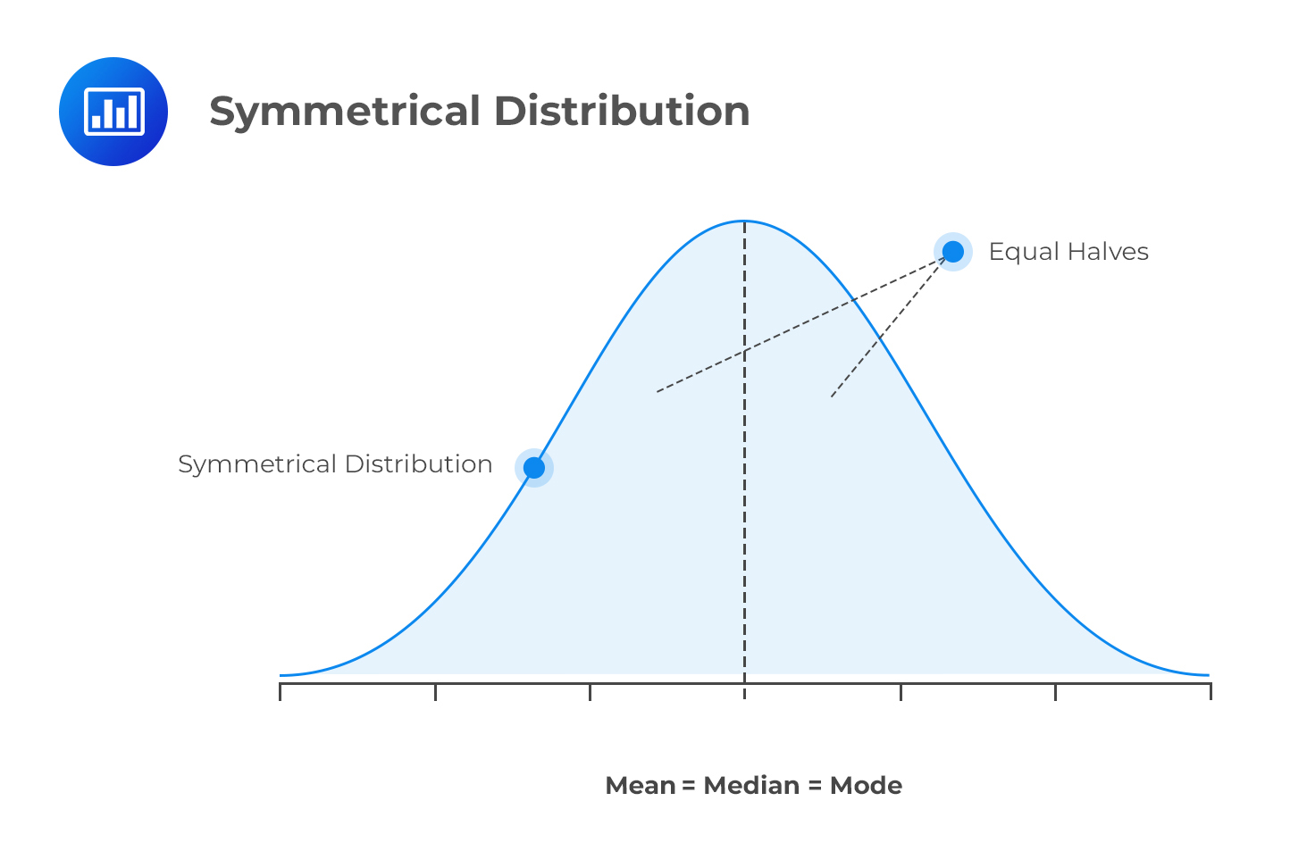
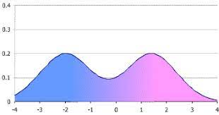
A Symmetric
A symmetric distribution or curve is one in which there are two equal halves, mirror images of each other

Slide 33
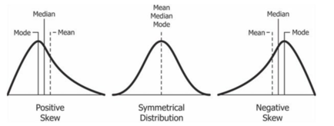
Skewness
Skewed curve: Nonsymmetric or asymmetric curves have a cluster of scores or a peak at one end and a tail extending toward the other end.

Slide 34
Skewness cont.,
The tail extends toward the left, in the direction of negative numbers.
The tail extends toward the right, in the direction of positive numbers on a scale

Slide 35
Modality
Refers to the most common or frequent score or scores in a distribution of scores.
It can help to identify patterns or trends in the data that may be helpful in making decisions or drawing conclusions about the test takers.
For example, if the modality of test scores is clustered around a certain score range, it may indicate that the test takers in that range have similar abilities or knowledge.

Slide 36
Modality cont.,
One peak

Slide 37
Kurtosis
It is a measure of the "peakedness" or "flatness" of a distribution relative to a normal distribution.
A positive kurtosis indicates a distribution with a more peaked shape, while a negative kurtosis indicates a distribution with a more flat shape.
Distributions with high kurtosis have more extreme values than distributions with low kurtosis.

Slide 38
Kurtosis cont.,
1. Leptokurtic: distribution has a higher peak and thicker tails than a normal distribution. This means that there is more of the data in the tails of the distribution than we would expect in a normal distribution. Leptokurtic distributions have a kurtosis greater than 3.
2. Mesokurtic: distribution is a normal distribution with a kurtosis of 3. This is the baseline for comparing the kurtosis of other distributions to a normal distribution.
3. Platykurtic: distribution has a lower peak and thinner tails than a normal distribution. The data is more tightly clustered around the mean than in a normal distribution. Platykurtic distributions have a kurtosis less than 3.

Slide 40
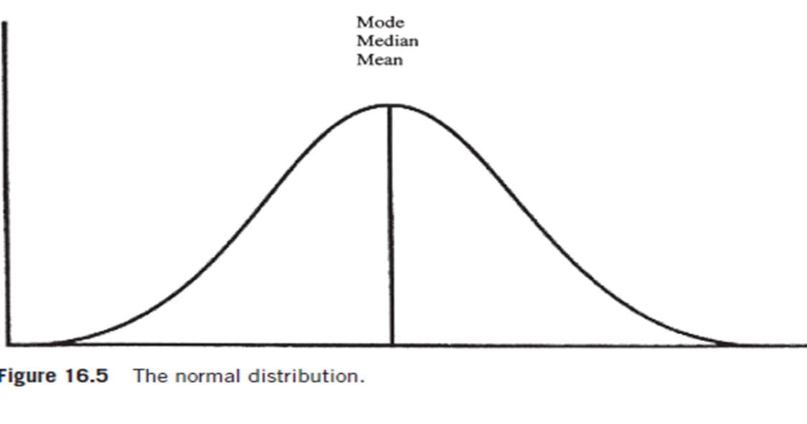
Normal Distribution
A normal distribution is a bell-shaped curve that is symmetric, unimodal, and mesokurtic

Slide 41
Note:
The shape of a score distribution depends on the characteristics of the test as well as the abilities of the students who were tested.

Slide 42
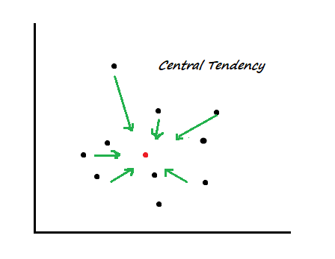
Measures of central tendency
A typical score is likely to be located in the middle of a distribution, surrounded by scores that cluster around it.
Measures of central tendency provide a value around which the test scores cluster.
Three measures of central tendency commonly used:
Mode
Median
Mean

Slide 43
Mode
Mode is the most frequently occurring actual score in the distribution. It can be identified easily from a frequency distribution or graphic display without mathematical calculation.
The mode may has two or more values in some distributions.
The uniform distribution of scores has no mode.

Slide 44
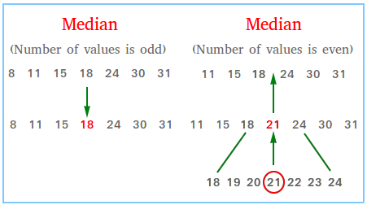
Median
Median is the point that divides the distribution of scores into equal halves.
In an even number of scores, the median is located halfway between the two middle scores.
In an odd number of scores, the median is the middle score.
Median is not influenced by the value of each score in the distribution.

Slide 45
Mean
is referred to as the “average” score in a distribution.
X$=\frac{\sum{X}}{n}$
$\sum{X}$: total scores
n: number of scores
The value of the mean is affected by every score in the distribution, so it is the preferred index of central tendency when a measure of the total distribution is desired.

Slide 46
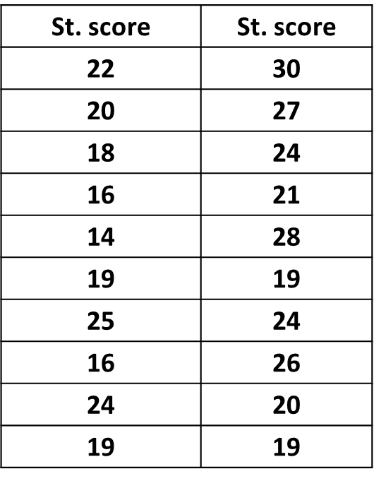
Example
The following scores represent 4th year students` performance in mid term nursing management Estimate mean , mode and median for this result
Number of students: 20

Slide 47
..
Ranking in ascending range:
14 16 16 18 19 19 19 19 20 20 21 22 24 24 24 25 26 27 28 30.
Mode = 19
Median = (20+21)/2= 20.5
Mean= $\frac{\sum{X}}{n}$= 431/ 20= 21.55

Slide 48
Measures of variability
Measures of variability are used to determine how similar or different the students are with respect to their scores on a test
1- Range
2- Standard Deviation

Slide 49
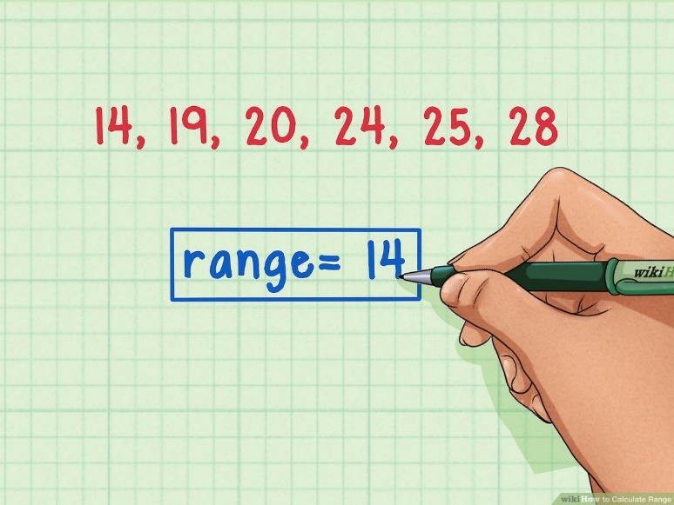
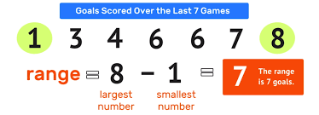
The Range
It is the difference between the highest and lowest scores in the distribution.
The range is sometimes expressed as the highest and lowest scores, rather than a difference score.

Slide 50
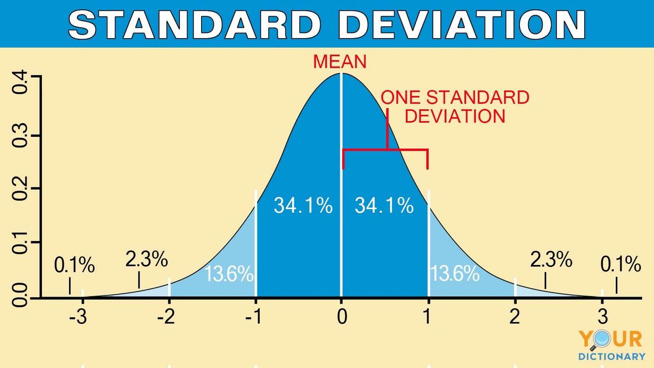
Standard deviation
Standard deviation: is the most common and useful measure of variability.
Standard deviation is based on differences between each score and the mean.

Slide 51
The standard deviation is calculated in four steps:-

Slide 52
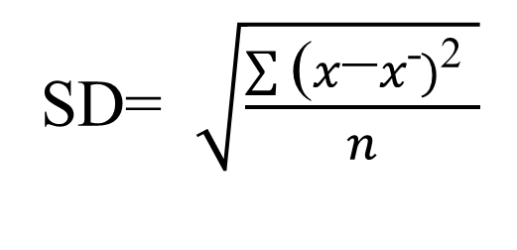
Measuring of standard deviation

Slide 53
Interpretation of individual test score:
Teacher-made test
Interpreting test of scores will assist the teacher to make norm-referenced interpretations of the meaning of any individual.
The teacher uses two items:
1- Percentage- correct score.
2- Percentile rank.

Slide 54
Percentage-correct score
The percentage-correct score is a calculated number that is frequently used to report the outcomes of criterion-referenced interpretation tests.
It is a comparison of a student’s score with the maximum possible score
it is calculated by dividing the raw score by the total number of items on the test
Percentage-correct score is a percentage representing how will student did perform out of 100%.
Percentage-correct score= raw score/ maximum possible score x 100.

Slide 55
The percentage-correct score…cont
For example
Raw score: 45
Maximum possible points: 50
Percent correct score: 45/50 x100= 90%

Slide 56
Percentile Rank
This interpretation is norm-referenced since percentile rank represents the student's relative position within a group.
Percentile rank of a given raw score is the percentage of scores in the distribution that occur at or below that score.
The percentile rank has nothing to do with the percentage of correct answers a student receives on a test; rather, it is a number that indicates the percentage of students in a certain group that received a lower raw score on a test than the student.

Slide 57
Percentile Rank formula:
Percentile rank = $\frac{c+0.5f}{N}$ $×$ 100
C….count of all scores less than the score of interest.
f……the frequency of score of interest.
N……the number of examinees in the sample

Slide 58
Example
Score
90
90
95
95
100
105
115
125
Calculate the Percentile Rank for the student who have 100 marks?
Total number of students = 8.
Percentile rank = $\frac{c+0.5f}{N}$ $×$ 100
Percentile rank= {(4+ 0.5 x 1) / 8} x 100
= 56%
The result means that the student score higher than 56% of scores made by students in the group.

Slide 59
Norm reference interpretation
Norm- referenced measures are used when the interest is in evaluating a subject’s performance relative to the performance of other subjects in some well-defined comparison group.
Norm-referenced refers to standardized tests that assess competency using norms to interpret and report scores.

Slide 60
Criterion Reference Interpretation
Is a type of assessment that evaluates an individual's performance or achievement against a set standard or criterion
The focus is on the mastery of specific knowledge, skills, or abilities rather than a comparison to the performance of others
The criterion or standard can be established through various means, such as expert judgment, industry standards, or a consensus of stakeholders.

Slide 61
Criterion Reference Interpretation
Criterion-referenced measurement is often used in educational settings to assess student learning and achievement.
Criterion-referenced measurement also used to determine an object’s status in relation to some specific attribute or property.
One of the main benefits, it provides a clear indication of what an individual knows or is able to do

Slide 62
Test scoring
Test scores are determined by a student’s performance in the various Items of a Test. Individual item scores can be tallied using different methods to produce the final test result.
The scoring method to be employed for a specific test is defined after that test has been created, before it can be used in an assessment.
calculate a score based on the ratio of correct to incorrect responses
generate a PASS or FAIL
apply a method which is defined externally (and imported)
calculate no score at all

Slide 63
Standardized Test:
Standardized tests are more relevant to general.
Results of standardized tests usually used to make norm-referenced interpretations.
It is more appropriate for evaluations of groups rather than individuals.
Standardized test scores should not be used to determine grades for a specific course or to make a decision to hire, promote, or terminate an employee.
Standardized tests provide gross , not precise, data about achievement.

Slide 64
Interpreting the Results of Standardized Tests
Actual differences in performance and achievement are reflected in large score differences.
Standardized test results usually are reported in derived scores such as percentile ranks, standard scores, and norm group scores
The teacher should select the norm group that most closely matches the group whose scores will be compared to it.

Slide 65
Steps of technology integration in test interpretation:
through | steps
Excel or Google Sheets | 1-Organize Your Data
averages, highest/lowest scores, pass/fail rates, mode, median, and mean . | 2-Use Spreadsheet Functions for Quick Insights
Graphs and Charts | 3-Visualize the Data
Excel / Google Sheets Python Script | 4-Automate Grading and Analysis
machine learning models | 5-Predictive or Diagnostic Insights
dashboards | 6. Dashboarding & Reporting
AI-powered Summary | 7-Natural Language Interpretation

Slide 66
Steps of technology integration in test interpretation cont;
1. Organize Your Data (if not done already)
Use Excel or Google Sheets to structure data like: | Student Name | Subject | Score | Max Score | Grade | Comments |
2- Use Spreadsheet Functions for Quick Insights
Calculate averages, highest/lowest scores, pass/fail rates, mode, median, and mean .
Use conditional formatting to highlight performance (e.g., red for low scores, green for high).

Slide 67
technology integration in test interpretation cont;
3- Visualize the Data
Graphs and Charts (bar charts for comparison, pie charts for pass/fail ratio).
4- Automate Grading and Analysis (with Python or AI tools)
Excel / Google Sheets – Simple Automation
Python Script – Full Automation & Analysis

Slide 68
technology integration in test interpretation cont;
5. Predictive or Diagnostic Insights (AI/ML-based)
Use machine learning models to:
Predict future performance
Identify students at risk
Cluster students by learning patterns
6. Dashboarding & Reporting:
-Build interactive dashboards
-Share results with stakeholders in a more digestible format

Slide 69
technology integration in test interpretation cont;
7-Natural Language Interpretation (AI-powered Summary)
-Use AI tools to summarize:
“This class had a 75% average with 60% scoring above 80%. Student X showed the most improvement...”
-Recommendations:
Provide targeted support for underperforming students.
Consider enrichment activities for high-achieving students.
Focus on reinforcing lower-graded concepts to close the knowledge gap

Slide 70
Benefits of Technology Integration in Test Interpretation:
Speed: Technology can process and interpret results faster than traditional methods, especially when it involves large datasets.
Accuracy: AI and machine learning models improve the accuracy of test interpretation by analyzing complex data patterns more efficiently than humans.
Personalization: AI-powered systems can offer personalized feedback and solutions, especially in education, by adapting tests to the learner’s needs.
Accessibility: Technology ensures that tests and their interpretations are more accessible, catering to individuals with various needs and abilities.
Cost Efficiency: Over time, automating test interpretation processes reduces the need for human intervention, saving both time and money.

Slide 71
Reference
-Papageorgiou, Spiros, and Venessa F. Manna. Meaningful Language Test Scores: Research to Enhance Score Interpretation. John Benjamins Publishing Company,( 2023).
-Reynolds, C. R., Altmann, R. A., & Allen, D. N. (2021). The meaning of test scores. In Mastering Modern Psychological Testing: Theory and Methods (pp. 91-131). Cham: Springer International Publishing
.‏-Oermann, M. H., Gaberson, K. B., & De Gagne, J. C. (2024). Evaluation and testing in nursing education..‏
-Kubiszyn, T., & Borich, G. D. (2024). Educational testing and measurement. John Wiley & Sons
-Ma, X. (2024). Artificial intelligence-driven education evaluation and scoring: Comparative exploration of machine learning algorithms. Journal of Intelligent Systems, 33(1), 20230319
-Li, Y. (2024). The Application of Artificial Intelligence in Exam Evaluation. Procedia Computer Science, 243, 1222-1230
-Allen, J., & Cruce, T. (2025). Initial Evidence Supporting Interpretations of Scores from the Enhanced ACT Test. Reading, 27(9), 36

